Slide 1

Automotive Technology: A Systems Approach, 8e
Chapter 39: Manual Transmission/Transaxle Service
Rob Thompson and Jack Erjavec, Automotive Technology: A Systems Approach, 8th Edition. © 2025 Cengage. All Rights Reserved. May not be scanned, copied or duplicated, or posted to a publicly accessible website, in whole or in part.

Slide 2
Chapter Objectives (1 of 2)
39.01 Check transmission oil level correctly, detect signs of contaminated oil, and change oil as needed.
39.02 Describe common in-vehicle transmission/ transaxle services.
39.03 Identify common transmission problems and their probable causes and solutions.

Slide 3
Chapter Objectives (2 of 2)
39.04 Describe the steps taken to remove and install transmissions/transaxles, including the equipment and safety precautions used.
39.05 Perform a visual inspection of transmission/ transaxle components for signs of damage or wear.
39.06 Describe the basic steps and precautions taken during transmission/transaxle disassembly, cleaning, inspection, and reassembly procedures.

Slide 4
Transmission Identification
A transmission cannot accurately be identified by the way it looks.
Always use the identification numbers found stamped on the case or on a metal tag.
Use the service manual for further identification.

Slide 5
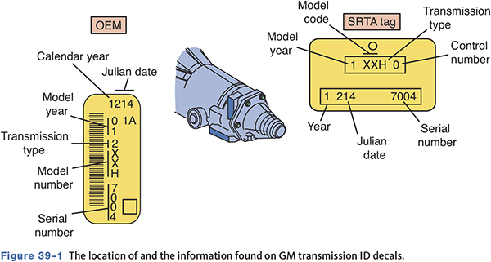
GM Transmission I.D.

Slide 6
Lubricant Check
39.01 Check transmission oil level correctly, detect signs of contaminated oil, and change oil as needed.
Should be checked at regular maintenance intervals.
Check oil with the engine off.
May have a dipstick or a check/fill plug.
Lubricants in use today include single and multi-viscosity oils, engine oil, special hydraulic fluids, and ATF.

Slide 7
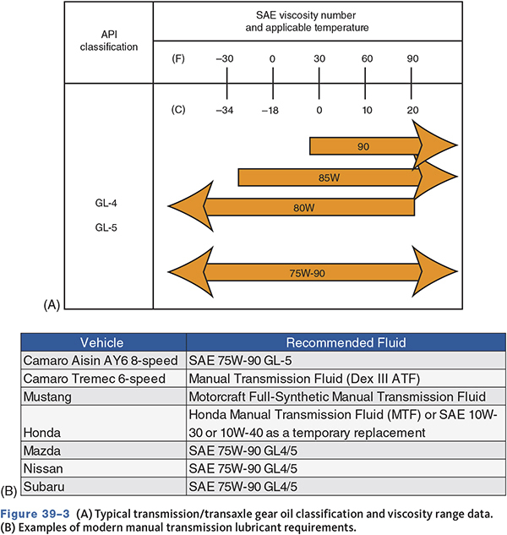
A) Typical transmission/transaxle gear
B) Examples of Modern Manual Transmission

Slide 8
Lubricant Leak Causes (1 of 2)
Too much lubricant in the unit.
Gear oil foaming, because the wrong type is being used.
Broken input shaft bearing retainer.
Loose or missing case bolts.

Slide 9
Lubricant Leak Causes (2 of 2)
Cracked or porous case.
Shift lever seal leak.
Gaskets or seals damaged or broken.
Loose drain plug.
Poor extension housing mounting.
Worn rear bushing and/or seal.

Slide 10
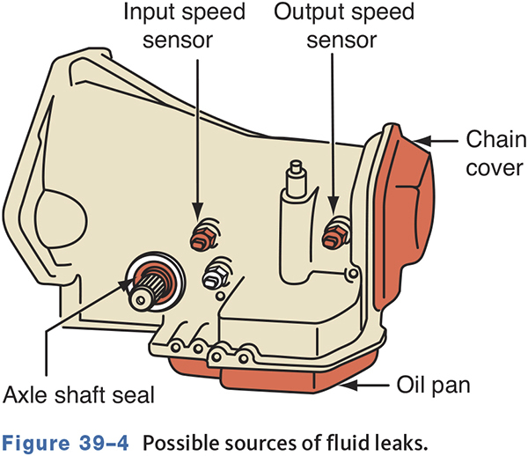
Possible Sources of Fluid Leaks

Slide 11
Fluid Changes
Refer to manufacturers recommendations.
Inspect drained fluid for brass and other metallic particles.
Insert and sweep a small magnet inside of the drain hole.
Refill with correct fluid until the fluid begins to run out of the filler hole.

Slide 12
In-Vehicle Service
39-02 Describe common in-vehicle transmission/ transaxle services.
Much service and maintenance work can be performed in-vehicle.
Rear oil seal and bushing replacement.
Linkage adjustment.
Backup light switch service.
Speedometer drive gear service.

Slide 13
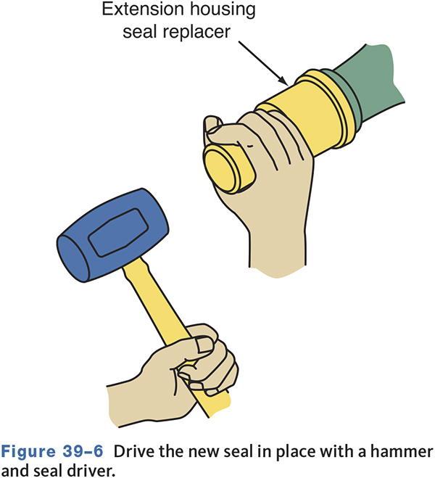
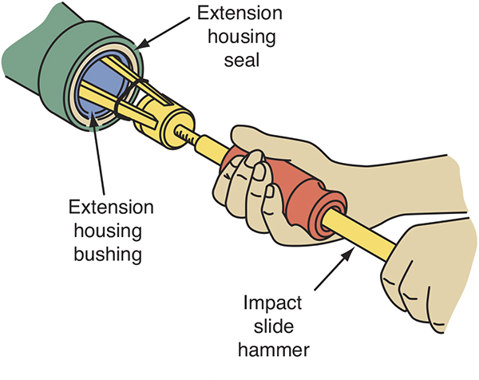
Replacing an Extension Housing Seal

Slide 14
Linkage Adjustment
Some external linkages provide adjustment.
May need adjusting for wear.
May need adjusting after transmission has been removed.

Slide 15
Back-Up Light Switch
Disconnect the electrical lead to the switch, put the transmission into reverse gear, and remove the switch.
To prevent fluid leaks, wrap the threads of a new back-up light switch with Teflon tape in a clockwise direction before installing it.

Slide 16
Knowledge Check (1 of 3)
When draining a manual transmission, brass particles are found in the fluid.
Technician A says this indicates worn bearings. Technician B says this indicates damaged gear teeth.
Who is correct?

Slide 17
Knowledge Check Answer (1 of 3)
When draining a manual transmission, brass particles are found in the fluid.
Technician A says this indicates worn bearings. Technician B says this indicates damaged gear teeth.
Who is correct?
  Answer: Neither Technician A nor B

Slide 18
Diagnosing Problems
39-03 Identify common transmission problems and their probable causes and solutions.
Always consult the service information as it often lists common problems
Proper diagnosis involves locating the exact source of the problem.
Many problems are actually caused by the clutch or differential.

Slide 19
Visual Inspection
Check for lubricant leaks.
Check for loose or broken mounts.
Check the shift linkage.
Check for loose bolts.
Check axle boots for cracks or damage.
Inspect CV joints.

Slide 20
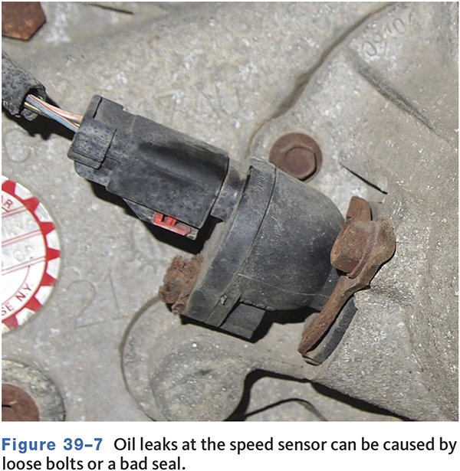
Leak Inspection

Slide 21
Noise Diagnosis (1 of 2)
Noise is heard when the clutch is engaged and the transmission is in neutral.
  It is usually caused by clutch or internal transmission problems.
Noise is heard only with the transmission in gear.
  It is usually caused by defective shaft bearings.

Slide 22
Noise Diagnosis (2 of 2)
Noise only occurs when the transmission is in a particular gear.
  Check only those components that have been engaged by selecting that gear.
Noise occurs when the engine is running with vehicle stopped.
  It can be related to engine, transmission, or exhaust.

Slide 23
Gear Clash
Indicated by a grinding noise during shifting.
Results from one gearset remaining partly engaged.
Can be caused by clutch adjustment or binding linkages.
Damaged, worn, or defective synchronizer blocking rings.
Improper lubricant.

Slide 24
Hard Shifting
Difficult to move from one gear to another.
Check clutch linkage adjustment.
Shift linkage problems.
Improper lubricant.
Worn bearings, damaged clutch gears, control rods, shift rails, shift forks, and synchronizers.

Slide 25
Jumping Out of Gear
Check shift lever and for worn or poorly adjusted shift linkage.
Excessive clearance between gears.
Badly worn bearings.
Inspect clutch pilot bearing, gear teeth, shift forks, shift rails, springs, and detents.
Misaligned drivetrain mounts.

Slide 26
Locked in Gear
Check gearshift linkage and shifter boots.
Inspect drivetrain mounts.
Low lubricant level can cause damage to needle bearings, gears, and synchronizers.
Inspect internal countergear, clutch shaft, reverse idler, shift rails, shift forks, springs, and detents for damage.

Slide 27
Knowledge Check (2 of 3)
Technician A says damaged powertrain mounts can cause jumping out of gear. Technician B says worn powertrain mounts can cause a transmission to stay locked in a gear.
Who is correct?

Slide 28
Knowledge Check Answer (2 of 3)
Technician A says damaged powertrain mounts can cause jumping out of gear. Technician B says worn powertrain mounts can cause a transmission to stay locked in a gear.
Who is correct?
  Answer: Both Technicians A and B

Slide 29
Transmission Removal Tips
39.04 Describe the steps taken to remove and install transmissions/transaxles, including the equipment and safety precautions used.
Always refer to the service information before beginning the removal
Always disconnect the battery before removing the transmission
Drain the fluid before removal
Use a transmission jack to support the transmission while removing it
On some cars, the engine and transmission must be removed as a unit.

Slide 30
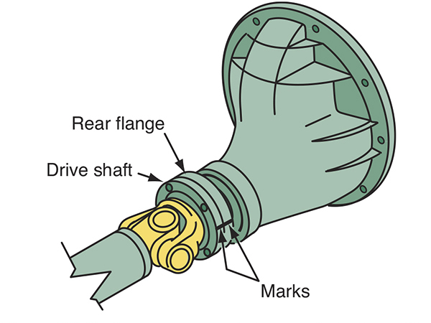
Rear Wheel Drive Removal

Slide 31
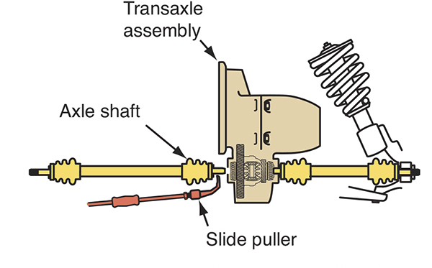
Front Wheel Drive Removal

Slide 32
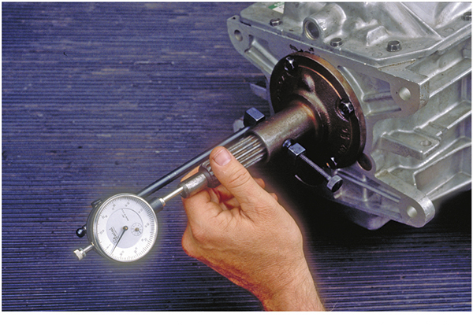
Cleaning and Inspection
39.05 Perform a visual inspection of transmission/transaxle components for signs of damage or wear.
Thoroughly clean the transmission/transaxle.
Disassembly and overhaul procedures can vary greatly between manufacturers.
  Pay close attention to part condition during removal.

Slide 33
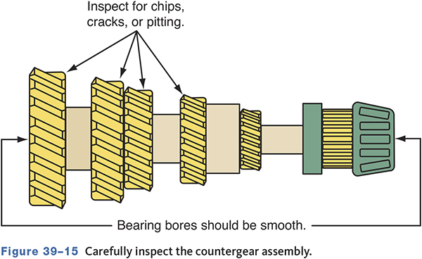
Counter Gear Inspection

Slide 34
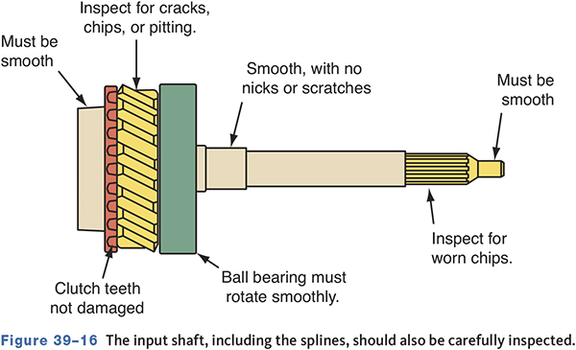
Input Shaft Inspection

Slide 35
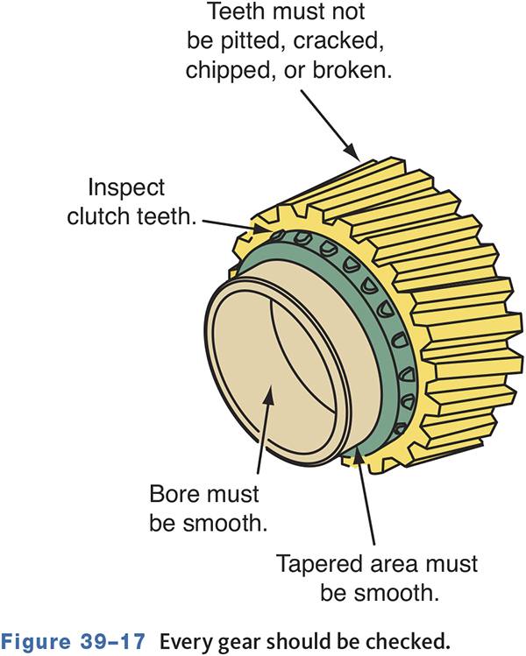
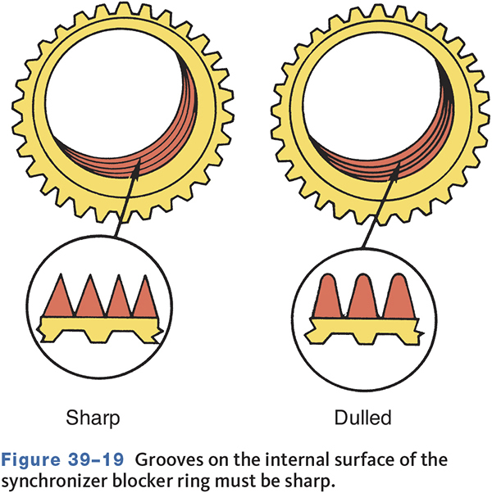
Gear and Synchronizer Inspection

Slide 36
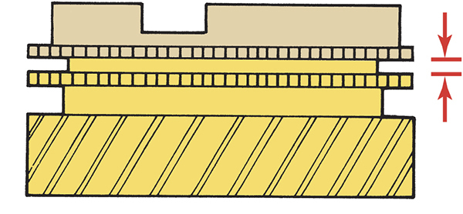
Synchronizer Clearance

Slide 37
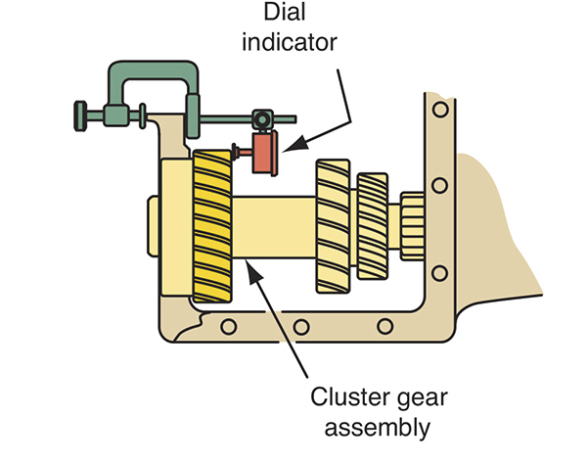
Typical Endplay Measurement

Slide 38
Knowledge Check (3 of 3)
While inspecting the synchronizers of a transaxle: Technician A says that if the clutch teeth of the synchronizer are rounded, the synchronizer assembly must be replaced. Technician B says that the movement of the synchronizer sleeve on the shaft should be checked.
Who is correct?

Slide 39
Knowledge Check Answer (3 of 3)
While inspecting the synchronizers of a transaxle: Technician A says that if the clutch teeth of the synchronizer are rounded, the synchronizer assembly must be replaced. Technician B says that the movement of the synchronizer sleeve on the shaft should be checked.
Who is correct?
Answer: Both technician A and B

Slide 40
Differential Case Disassembly
39.06 Describe the basic steps and precautions taken during transmission/transaxle disassembly, cleaning, inspection, and reassembly procedures.
The differential is often kept together when repairing a transaxle.
Separate the ring gear from the case.
Clean and inspect all parts.
Keep all shims and bearing races together and identified.
Discard the original shim if a service shim is used.

Slide 41
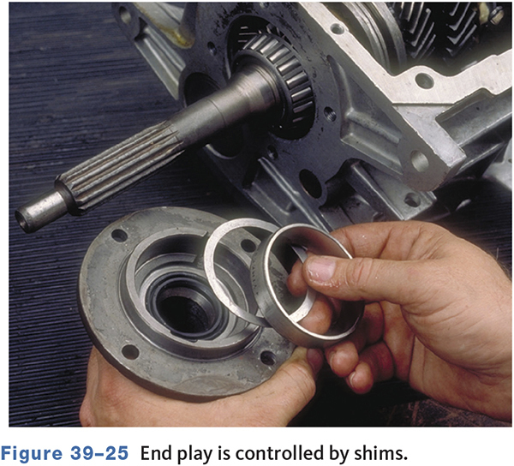
Differential Case Reassembly
Refer to service manual for procedures.
Press serviceable gears onto main shaft.
Use petroleum jelly to hold needle bearings.
Adjust endplay with shims, spacers, or snap rings of different thicknesses.

Slide 42
Installing the Transmission/Transaxle
Install the clutch assembly and new release bearing.
Do not let transmission hang by the input shaft.
Lightly coat the input shaft with lubricant
  Avoid putting too much grease on the shaft.
Tighten bell housing bolts evenly.
If the transmission/transaxle does not fit snugly against the engine block or if you cannot move the transmission into place, do not force it.

Slide 43
Chapter Reflection
Describe a concept from this chapter that challenged you the most. Describe what made the concept difficult for you and the steps you took to improve your understanding.
How could you help another learner who was struggling with the same concept.
Use 100–150 words in your answer.

